Slide 1

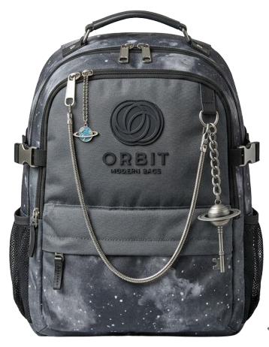

DIGITAL MARKETING ASSIGNMENT
E-mail Marketing
Submitted By – Bhavesh Khemani
BCA 3rd Semester
Session – 2026–2027

Slide 2

Digital Marketing
Assignment Report
ASSIGNMENT FOLIO
Assignment Folio of
Digital Marketing
Submitted to
Dezyne École College
Toward Digital Marketing
By
BCA
3rd Semester
Bhavesh Khemani
Dezyne École College
106/10, Civil Lines, Ajmer
www.dezyneecole.com
2026-2027

Slide 3
Digital Marketing
Assignment Report
ASSIGNMENT FOLIO
We take this opportunity to express our sincere gratitude to Dezyne École College for providing us with the knowledge, resources, and guidance essential to the successful completion of this project.
Our deepest thanks to our respected Principal, Dr. Vinita Mathur, for her visionary leadership and continuous encouragement. Her commitment to academic excellence and student growth has been a constant source of motivation and pride.
We are equally thankful to all our faculty members for their consistent support, expert advice, and valuable insights that shaped our learning and helped us achieve this milestone.
Lastly, we extend heartfelt thanks to everyone who directly or indirectly contributed to the success to this project.
We are proud to be part of Dezyne École College, an institution that truly nurtures professionalism, innovation, and purpose.
With Sincere appreciation,
Bhavesh Khemani
Department – BCA
Dezyne École College, Ajmer

Slide 4
Digital Marketing
Assignment Report
ASSIGNMENT FOLIO
Objective:
  Build Subscriber Base, Increase Engagement, Promote Products, Improve Conversions & Maximize ROI
Key Features:
1. Subscriber List Creation
  Created audience list in Mailchimp. Segmented subscribers based on interests and demographics.
2. Email Campaign Setup
  Selected regular email campaign and defined campaign name, audience, and subject line with strong CTA.
3. Email Designing
  Designed responsive email using drag-and-drop builder. Added logo, banner image, product details, and clear Call-to-Action buttons
4. Test Email & Optimization
  Sent test emails to check layout, links, subject line, and mobile responsiveness.
5. Final Publication & Performance Tracking
  Scheduled and sent final campaign. Monitored open rate, click-through rate (CTR), and conversions.

Slide 5
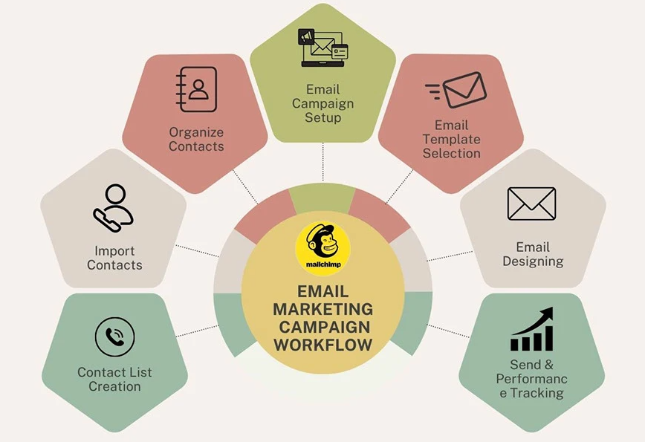

Slide 6

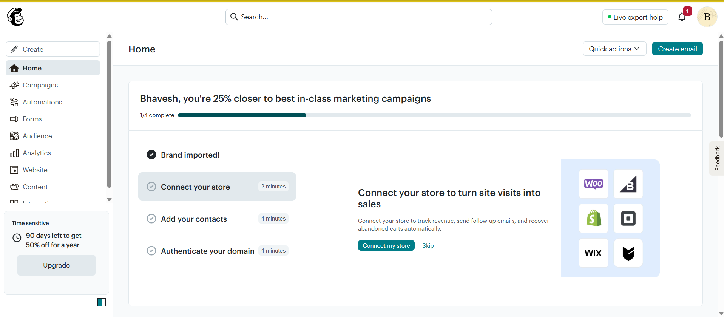
Mailchimp Account Setup

Slide 7
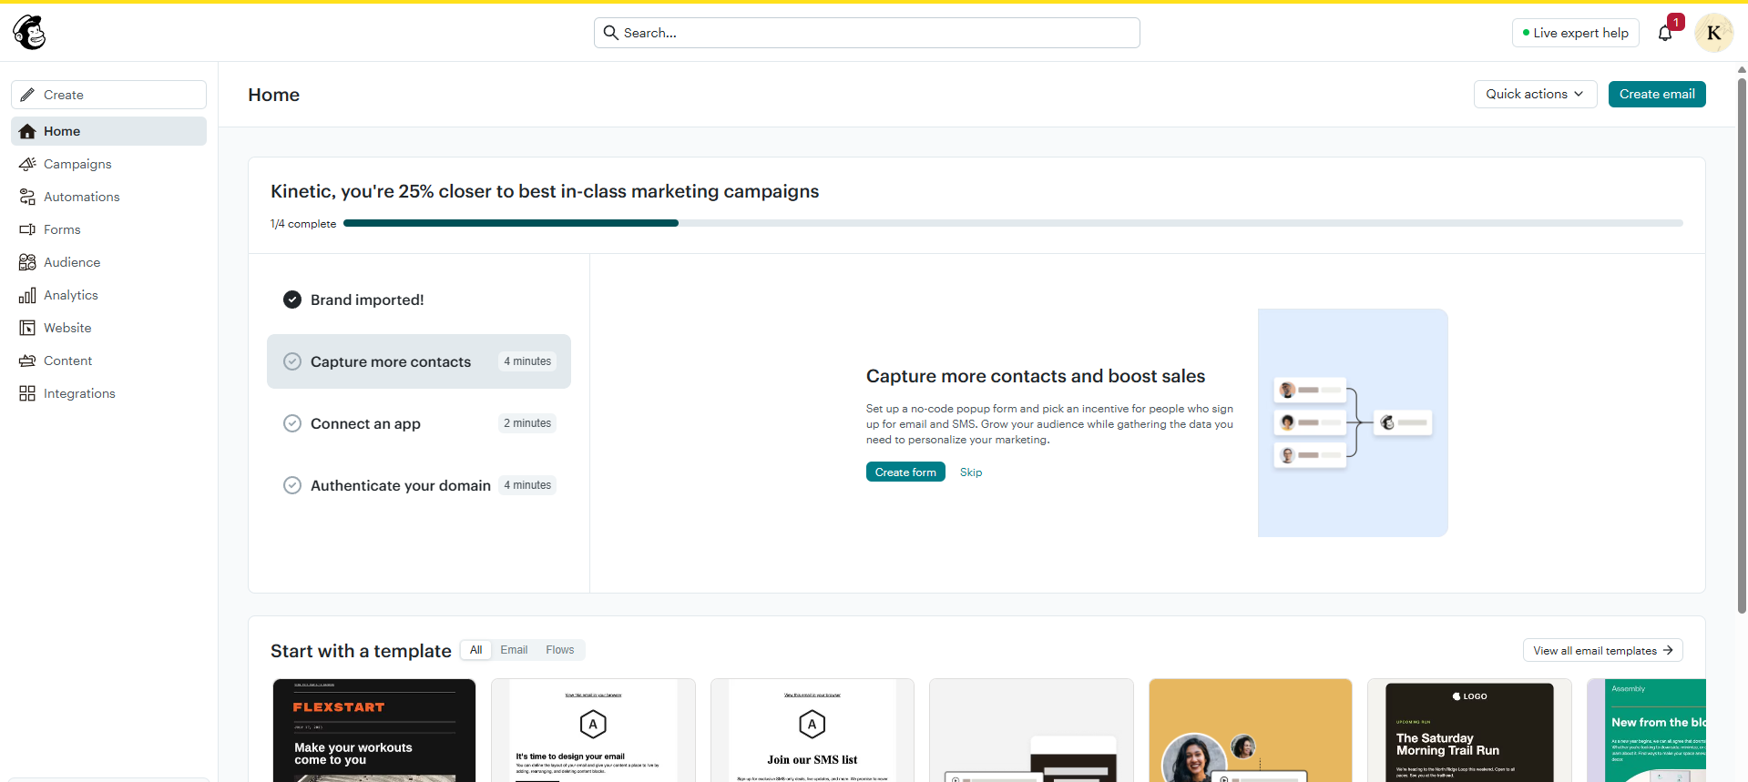
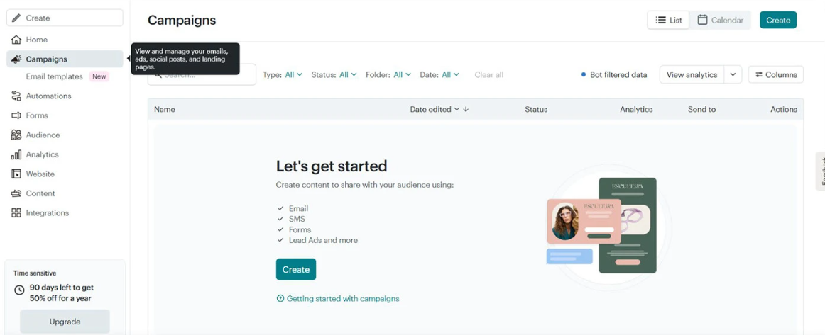
Email Campaign Dashboard

Slide 8
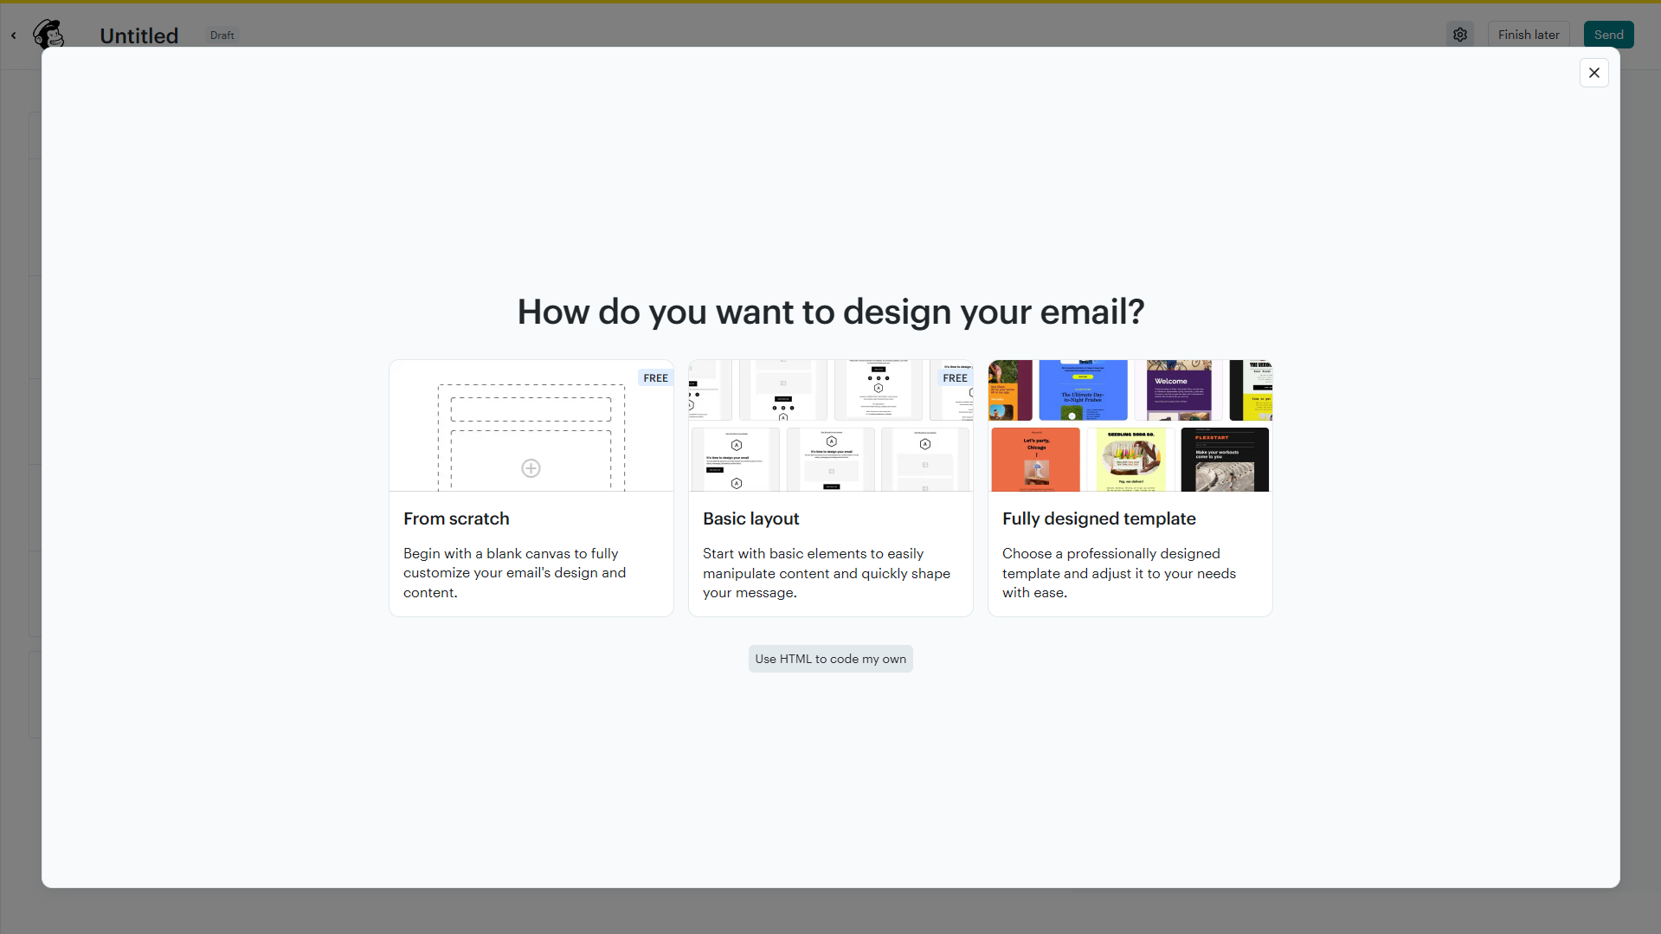
Email Design Method Selection

Slide 9
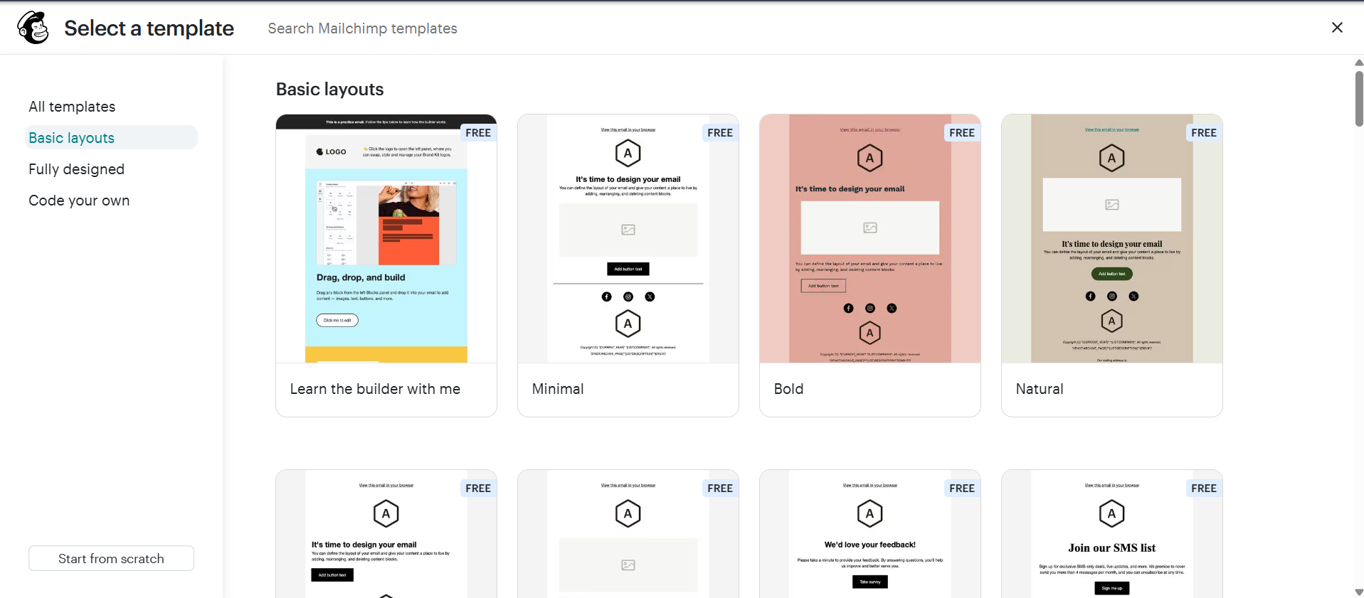
Email Template Selection

Slide 10
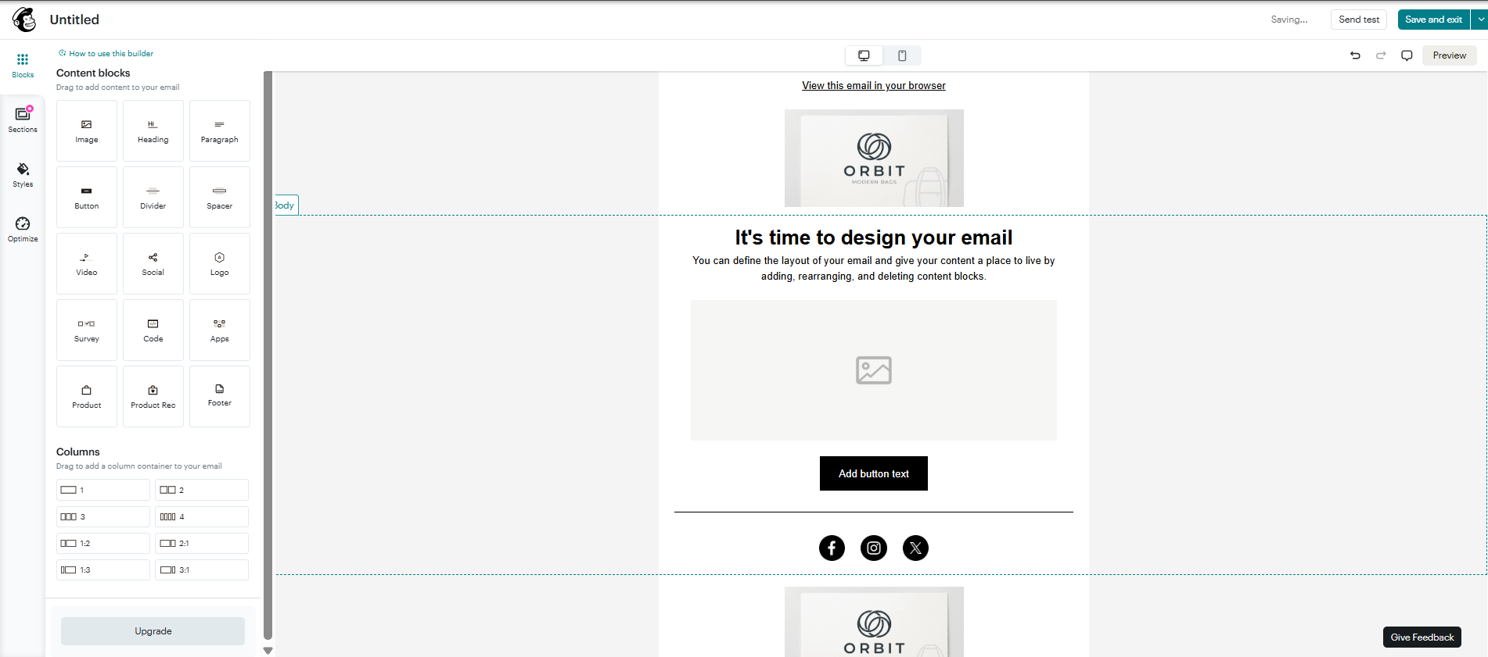
Email Design & Customization

Slide 11
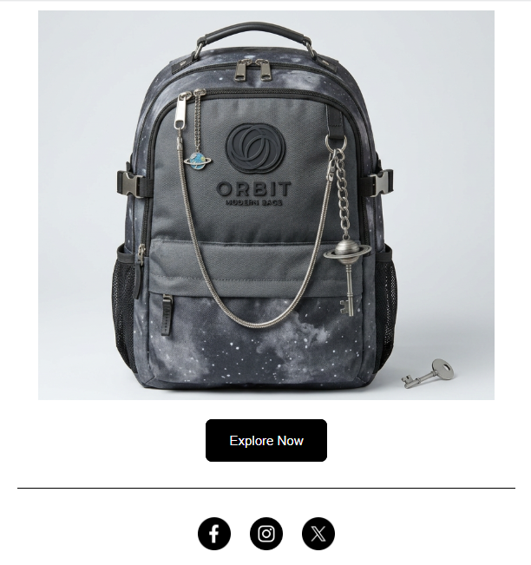
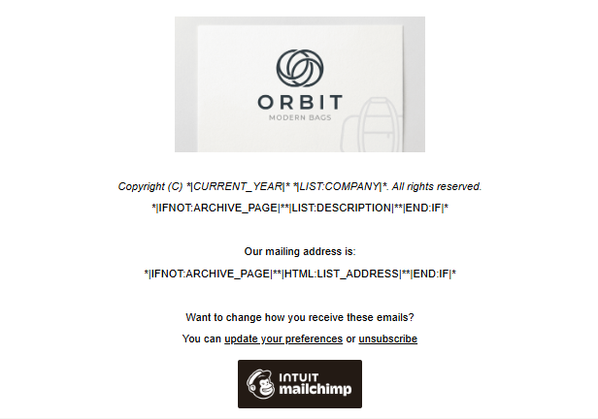

Email Design & Customization

Slide 12
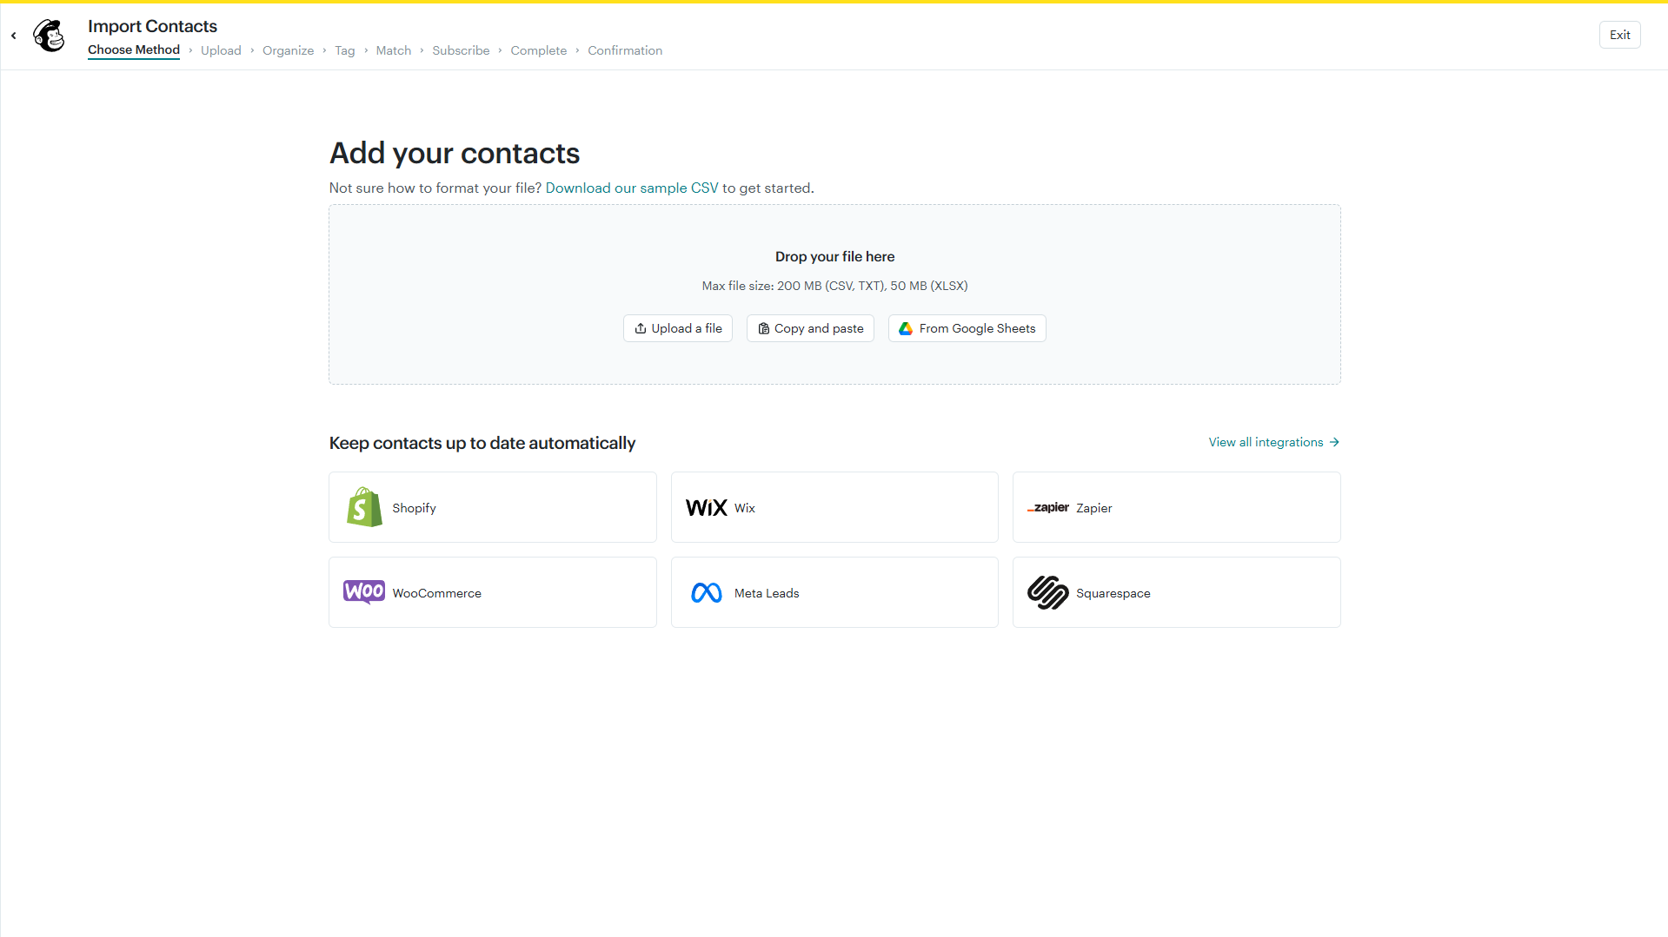
Contact Import Method Selection

Slide 13
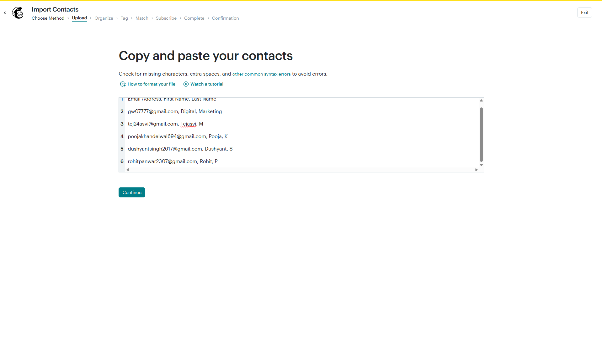
Copy & Paste Your Contact

Slide 14
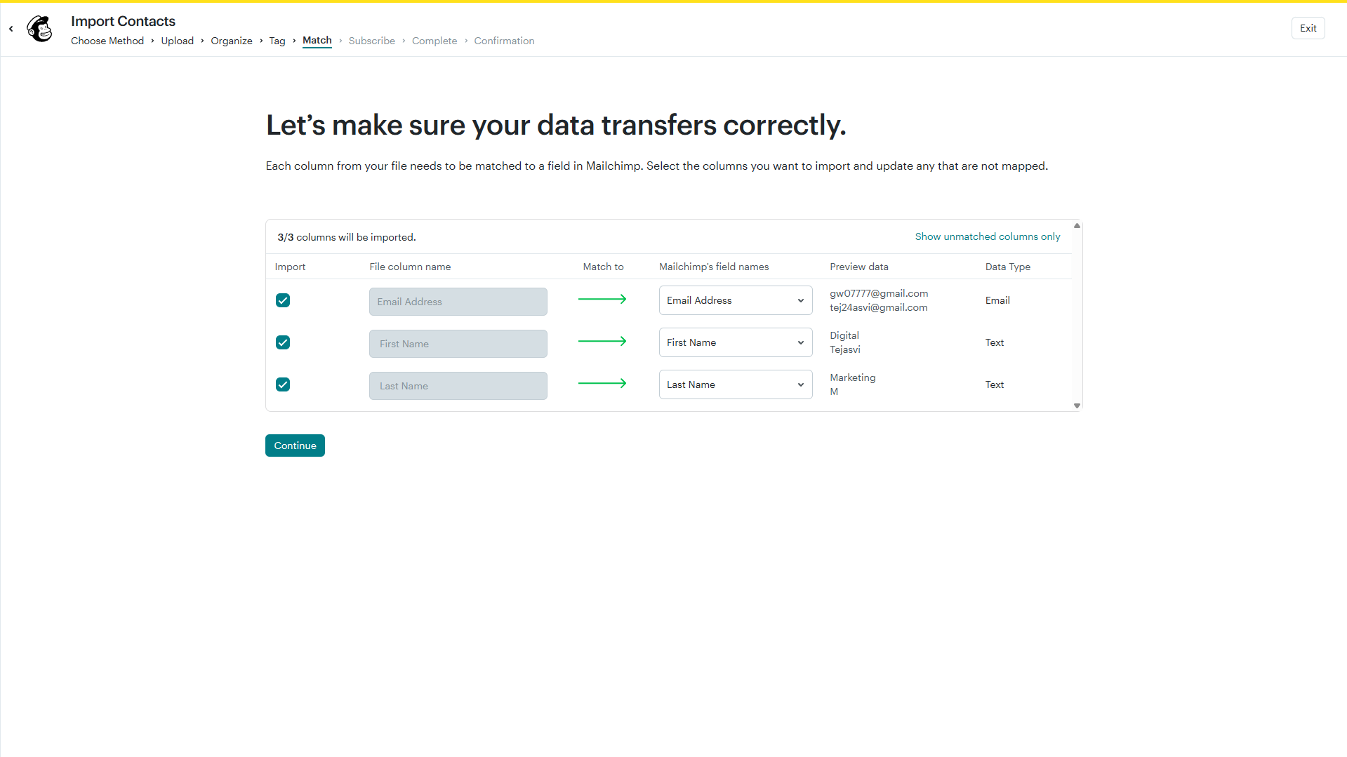
Contact Imported Successfully

Slide 15
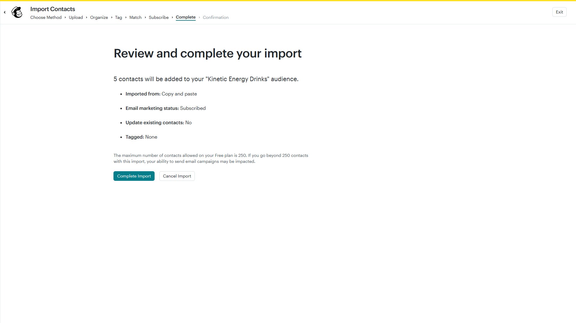
Import Completion

Slide 16
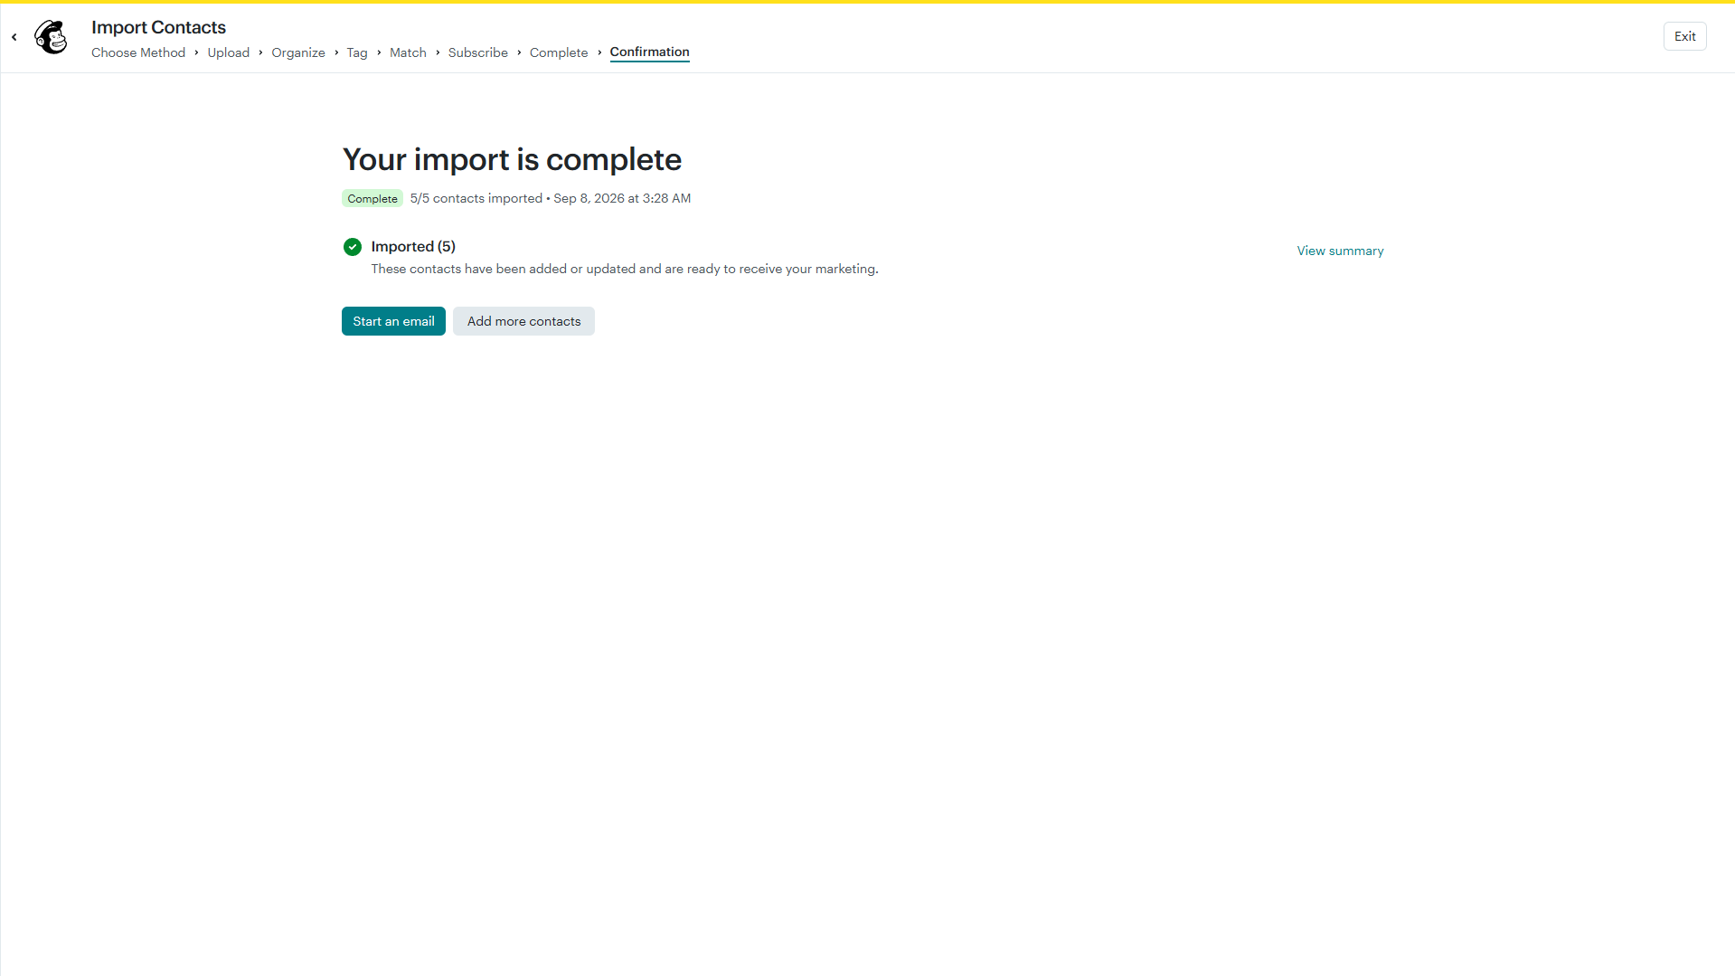
Import Confirmation

Slide 17
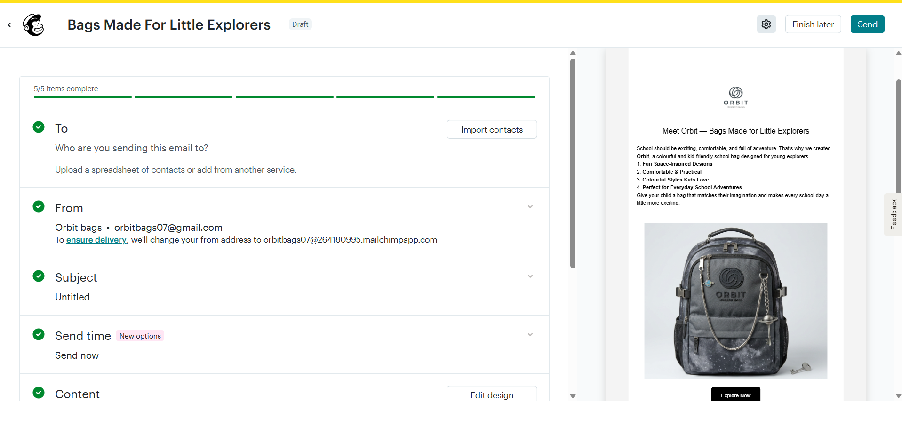
Campaign Preview

Slide 18
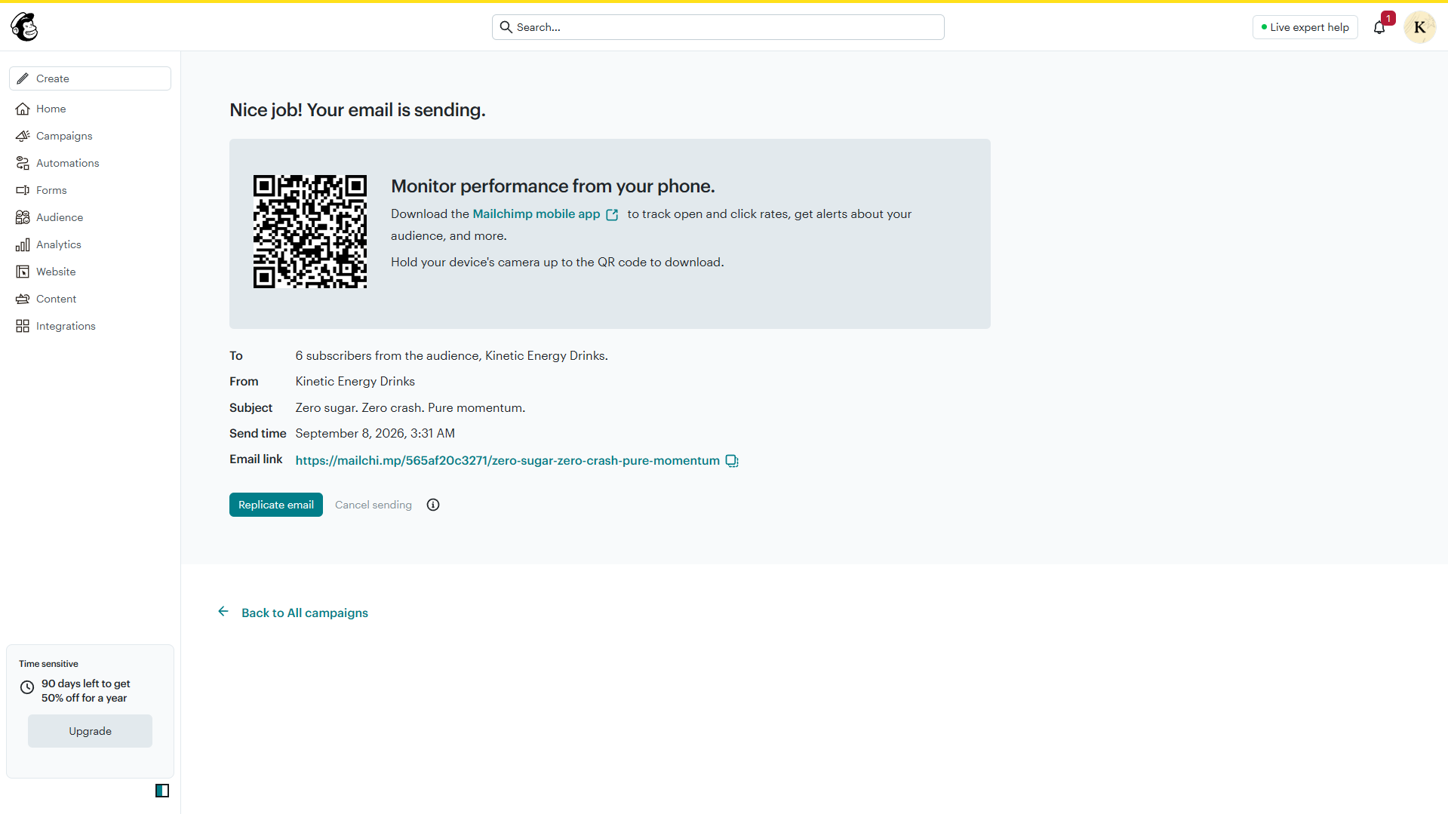
Campaign Successfully Launched

Slide 19
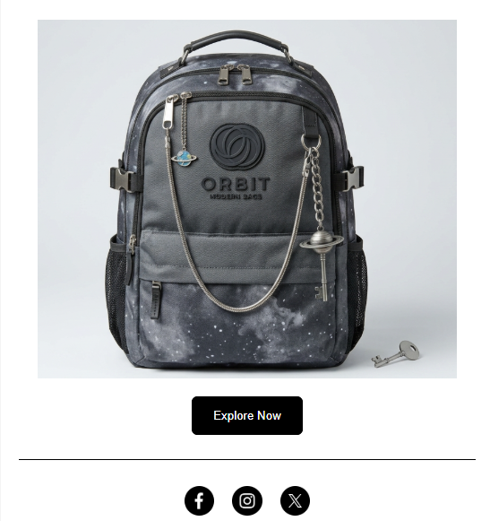
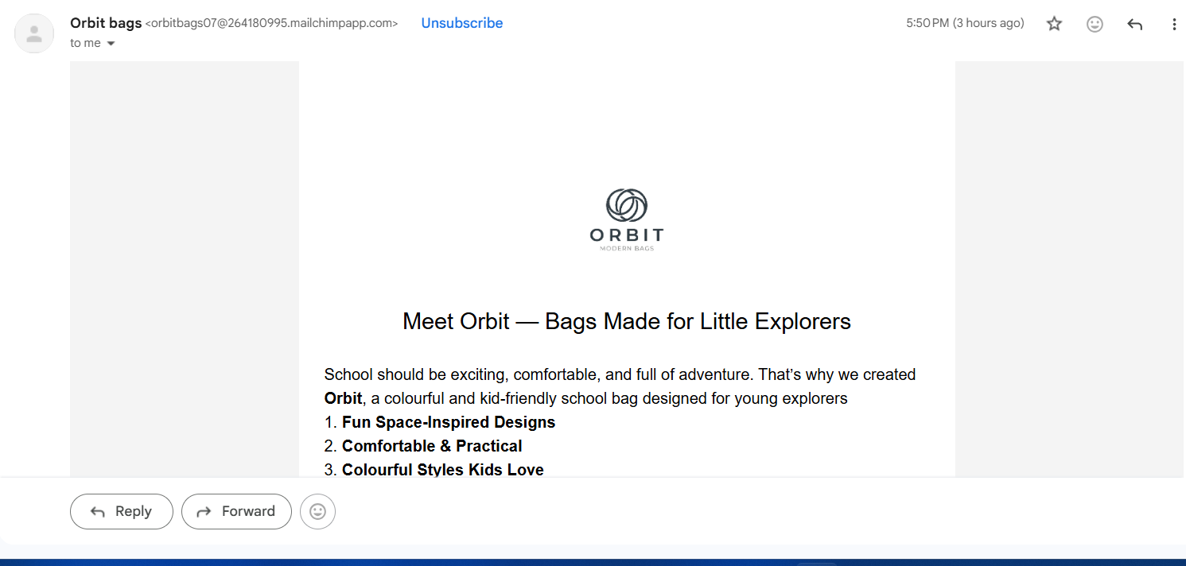
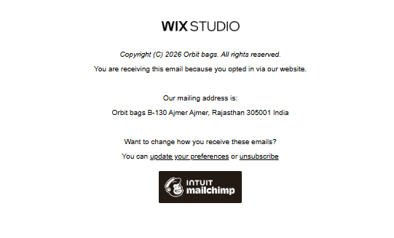
Test Email

